Slide 1


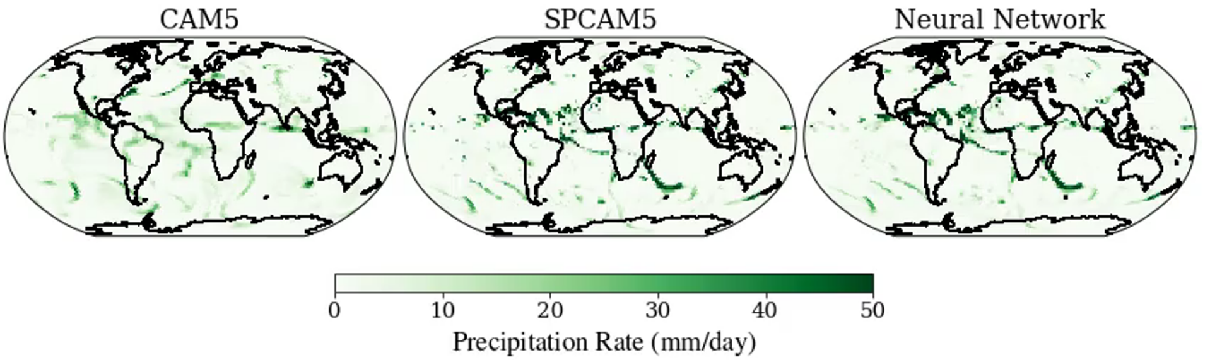
ML for Earth & Env Sci (Week 5, SP2022)
How can we emulate complex, nonlinear, high-dimensional environmental processes with machine learning?
Source: Mooers et al. (2021)
Notes:
First we see the SST, highlighting the fine-scale eddies and filaments present in the simulation.
Then we see density transformation by surface heat fluxes.
Finally we see density transformation by near-surface lateral mixing.

Slide 2
Min 15-45: Neural Networks for High-Dimensional, Nonlinear Processes
Learning Objectives (Géron Ch10 & Ch11):
Define an artificial neural network
Understand activation functions
Understand the steps & best practices to build an artificial neural network
Know the main hyperparameters defining a neural network’s architecture
Know the main hyperparameters controlling the training of a neural network

Slide 3
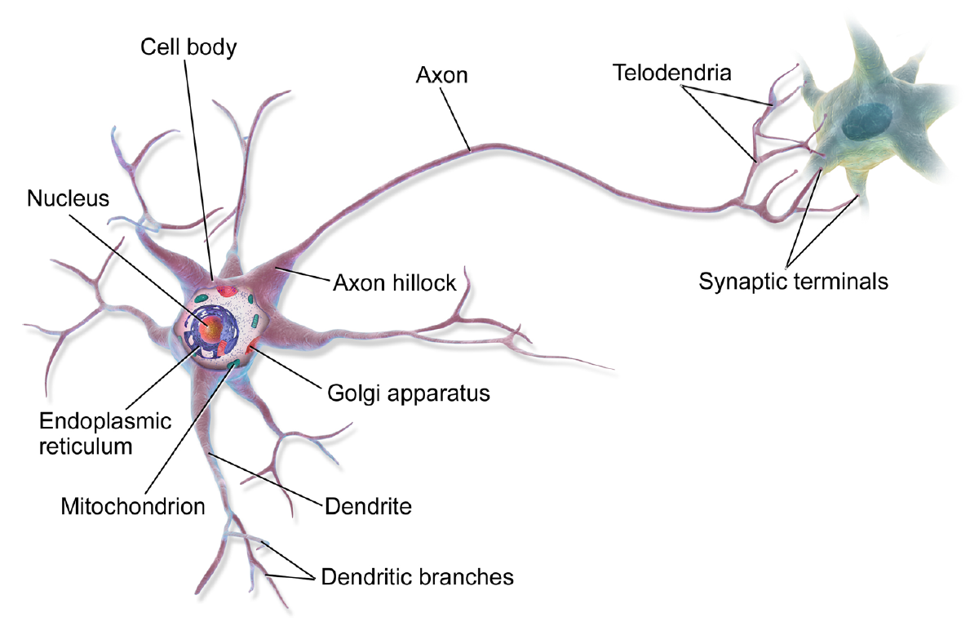
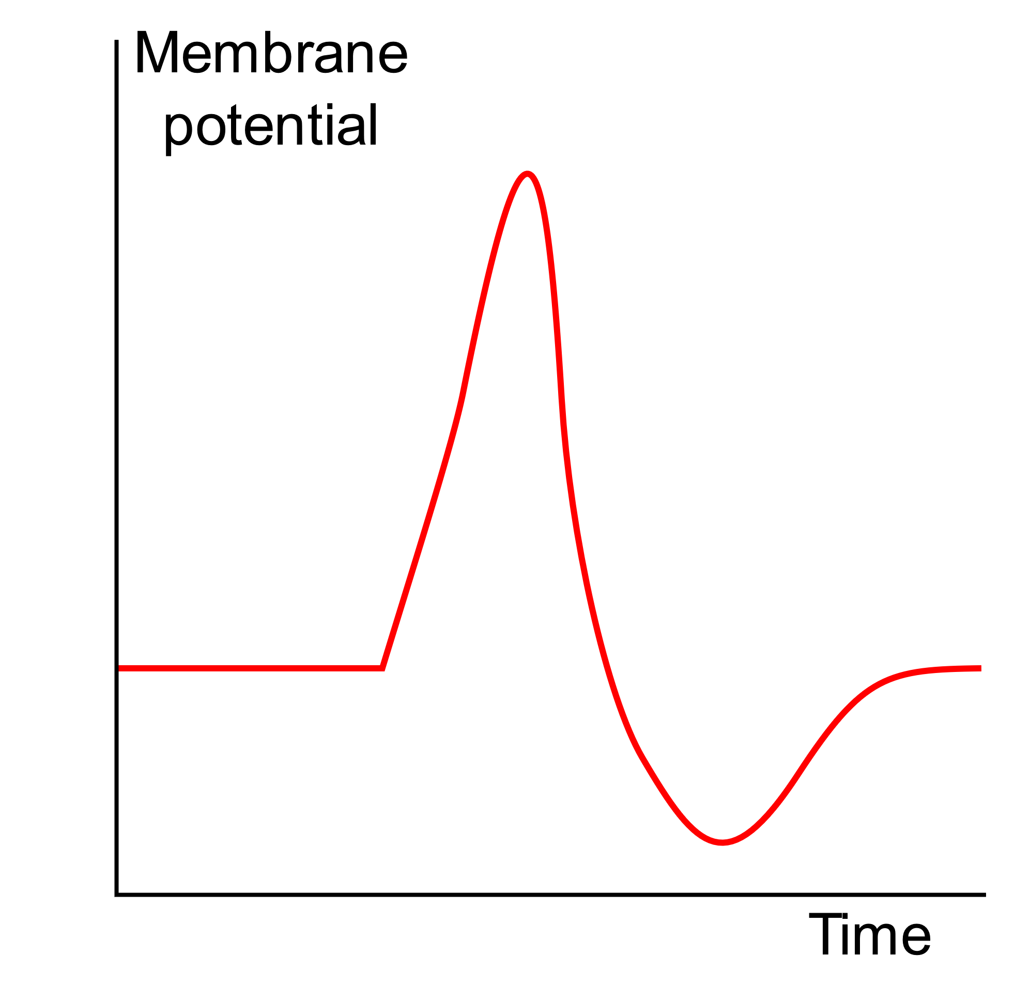
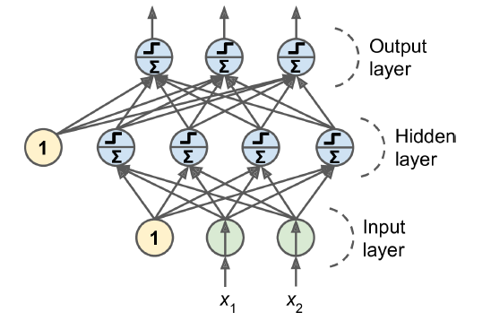
From biological to artificial neural networks
Action Potential
Source: https://commons.wikimedia.org/w/index.php?curid=44114666

Slide 4
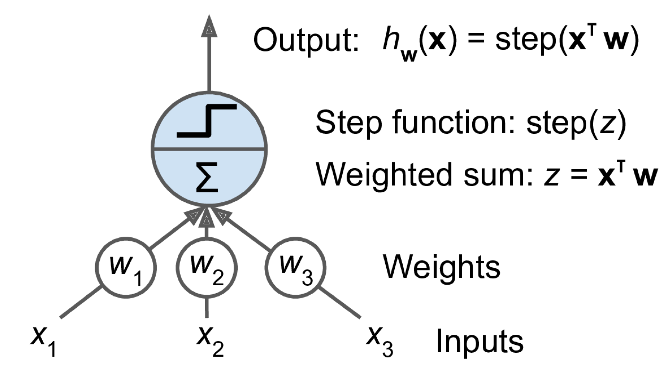
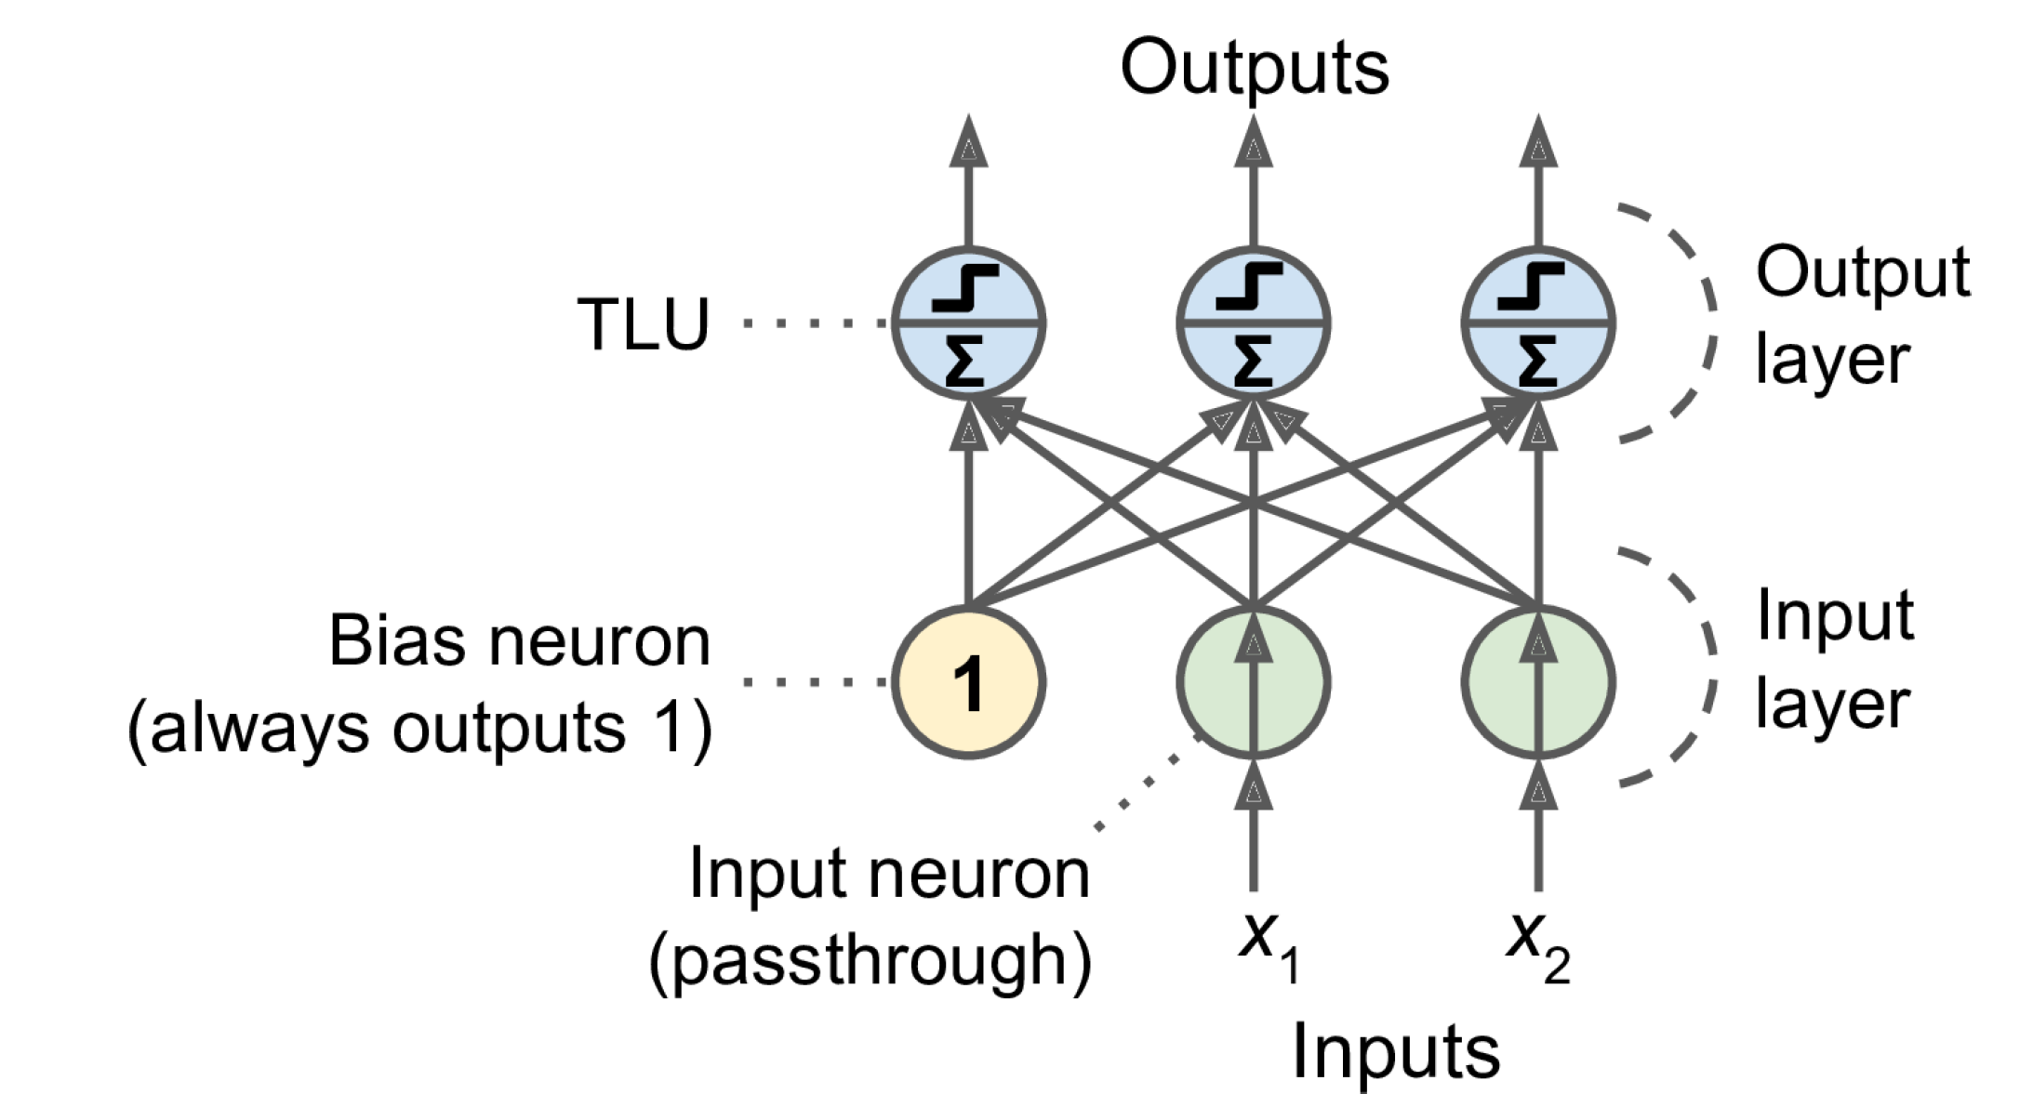
From the perceptron to a fully connected layer
3 inputs, 1 output
2 inputs, 3 outputs

Slide 5
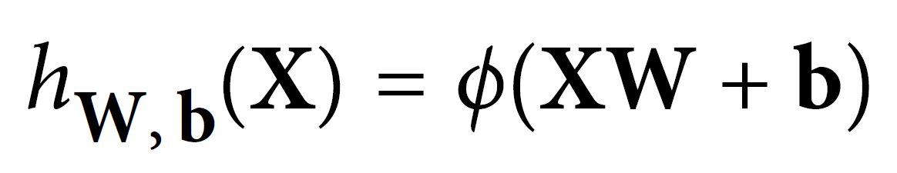
From the perceptron to a fully connected layer
Input Vector
Weight Matrix
Activation Function
2 inputs, 3 outputs
Bias Vector (Intercept)

Slide 6
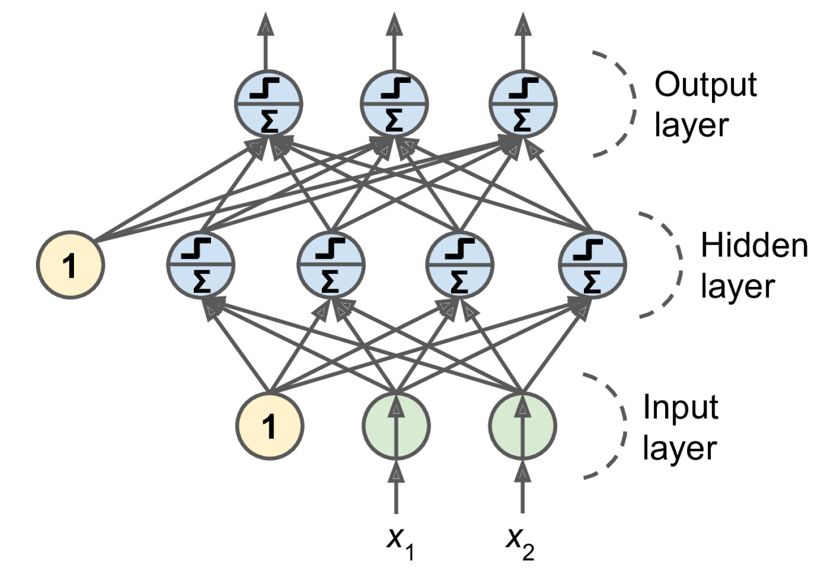
From fully connected layer to Multilayer Perceptron
Notes:
1 layer = similar to logistic regression
2 layers = shallow neural network
Deep learning = 3 layers and above

Slide 7
Feedforward neural network

Slide 8
Universal Approximation Theorem: By making an artificial neural network wide enough (large W) or by making an artificial neural network deep enough (many ϕ) A neural network can represent any continuous functions
Source: Cybenko & Hornik (1989), Leshno et al. (1993), Zhou et al. (2017)

Slide 9
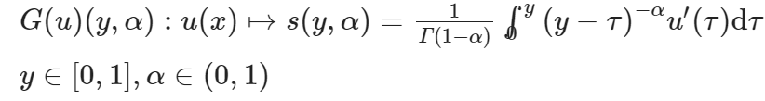
Universal Approximation Theorem: By making an artificial neural network wide enough (large W) or by making an artificial neural network deep enough (many ϕ) A neural network can represent any continuous functions
and even any nonlinear continuous operator
Source: Lu et al. (2021)

Slide 10
?
?
?
?

Slide 11


Adjusting the weights requires calculating the gradient of the loss
To calculate gradients, neural networks use automatic differentiation
Vanishing (0)/Exploding(∞)
Notes:
Vanishing gradient = Graident

Slide 12
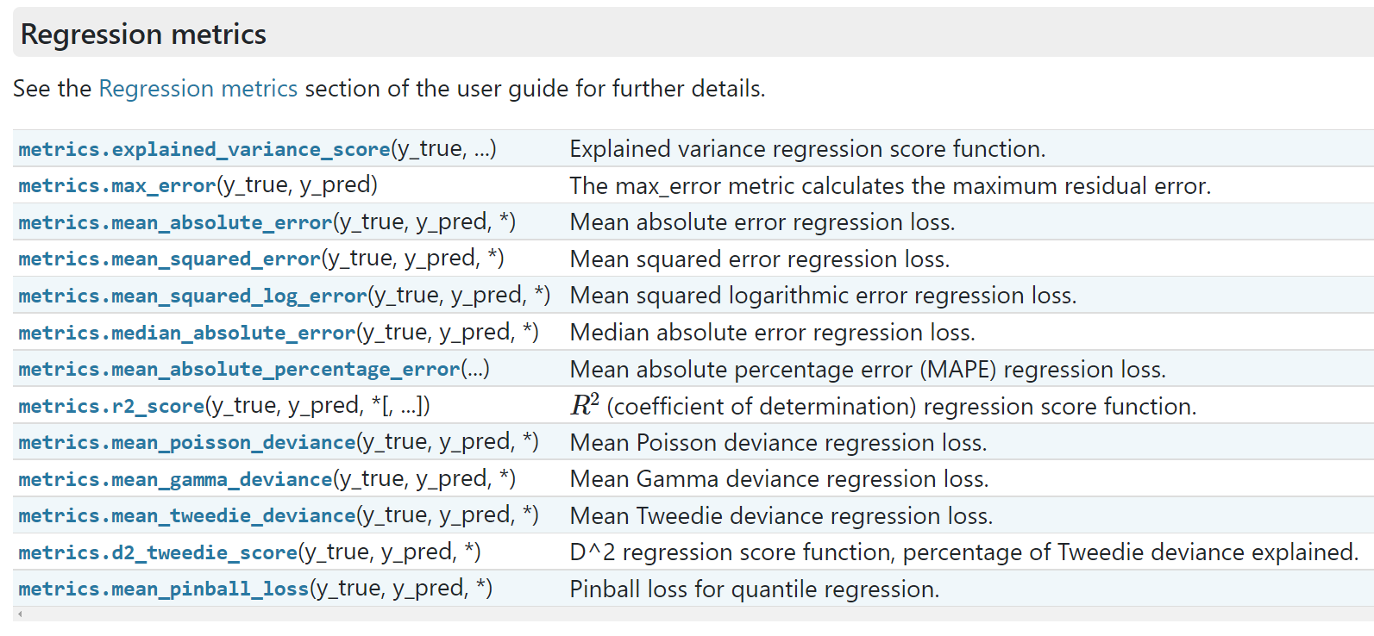
How to build a neural network in practice?
Define your problem (classification versus regression, loss function)

Slide 13
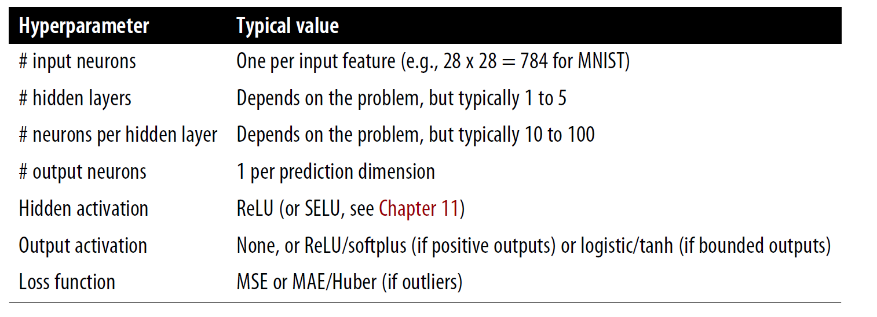
How to build a neural network in practice?
Define your problem (classification versus regression, loss function)
Pre-process the data (training/validation/test split, normalization/scaling)
Choose your architecture:

Slide 14

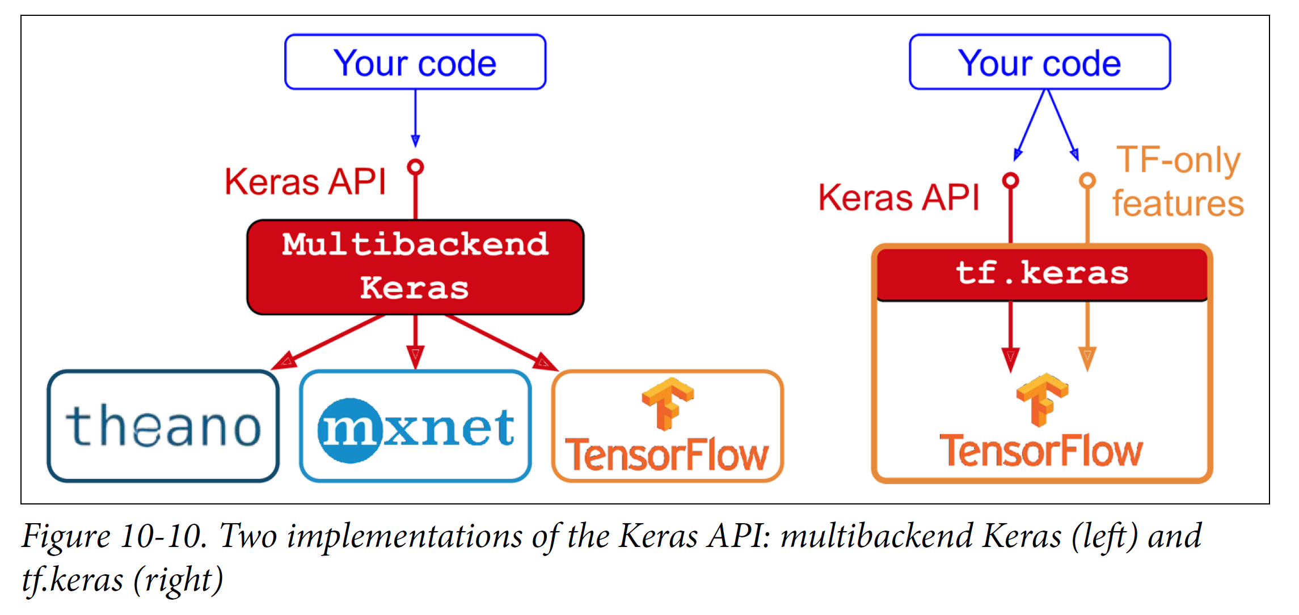
API = Application Programming Interface = Way for computer programs to communicate
Source: Géron

Slide 15
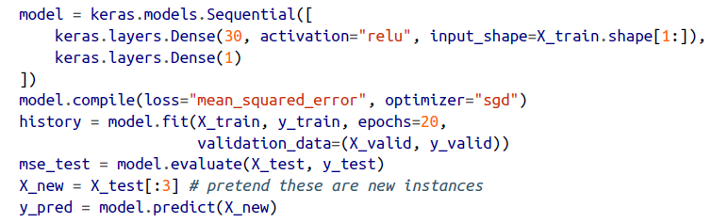
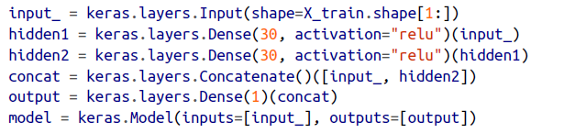
How to build a neural network in practice?
Define your problem (classification versus regression, loss function)
Pre-process the data (training/validation/test split, normalization/scaling)
Choose your architecture & implement it using sequential/functional API
Sequential API
Functional API

Slide 16
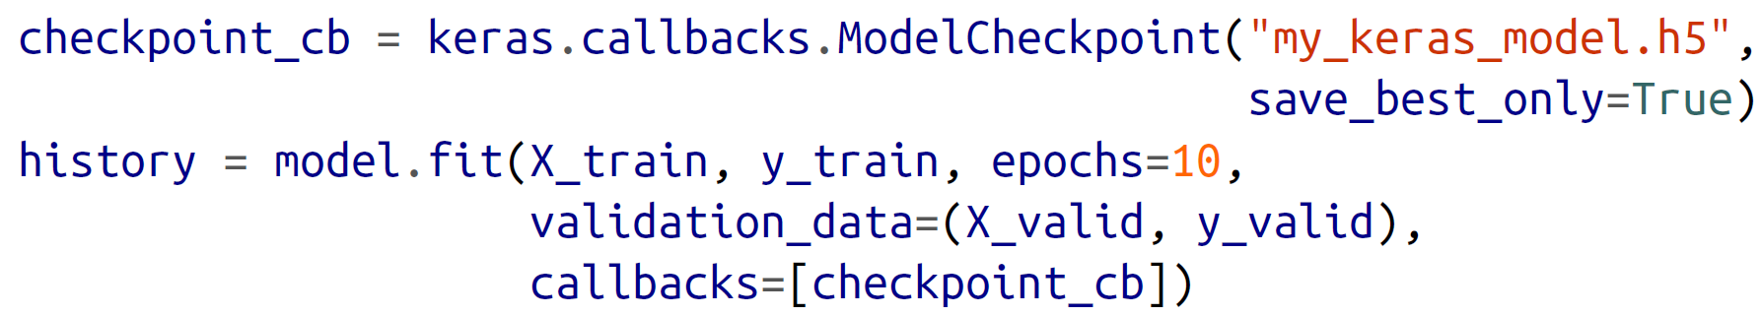
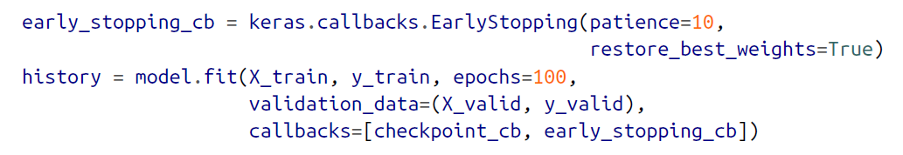
How to build a neural network in practice?
Define your problem (classification versus regression, loss function)
Pre-process the data (training/validation/test split, normalization/scaling)
Choose your architecture & implement it using sequential/functional API
Choose your training hyperparameters (learning rate, batch size, etc.)
Train your neural network on the training set
Use the validation set to optimize hyperparameters & for callbacks

Slide 17
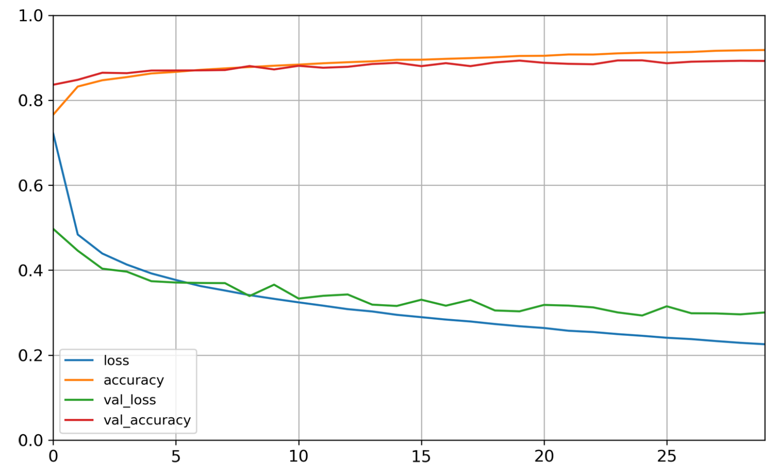
How to build a neural network in practice?
Define your problem (classification versus regression, loss function)
Pre-process the data (training/validation/test split, normalization/scaling)
Choose your architecture & implement it using sequential/functional API
Choose your training hyperparameters (learning rate, batch size)
Train your neural network on the training set
Use the validation set to optimize hyperparameters & for callbacks
#Epoch = Going through the entire training set once

Slide 18
How to build a neural network in practice?
Define your problem (classification versus regression, loss function)
Pre-process the data (training/validation/test split, normalization/scaling)
Choose your architecture & implement it using sequential/functional API
Choose your training hyperparameters (learning rate, batch size, etc.)
Train your neural network on the training set
Use the validation set to optimize hyperparameters & for callbacks (Hyperparameter optimization libraries = Hyperopt, Hyperas, Keras Tuner)
Your network is ready ☺ Evaluate it on the test set and you’re done!

Slide 19
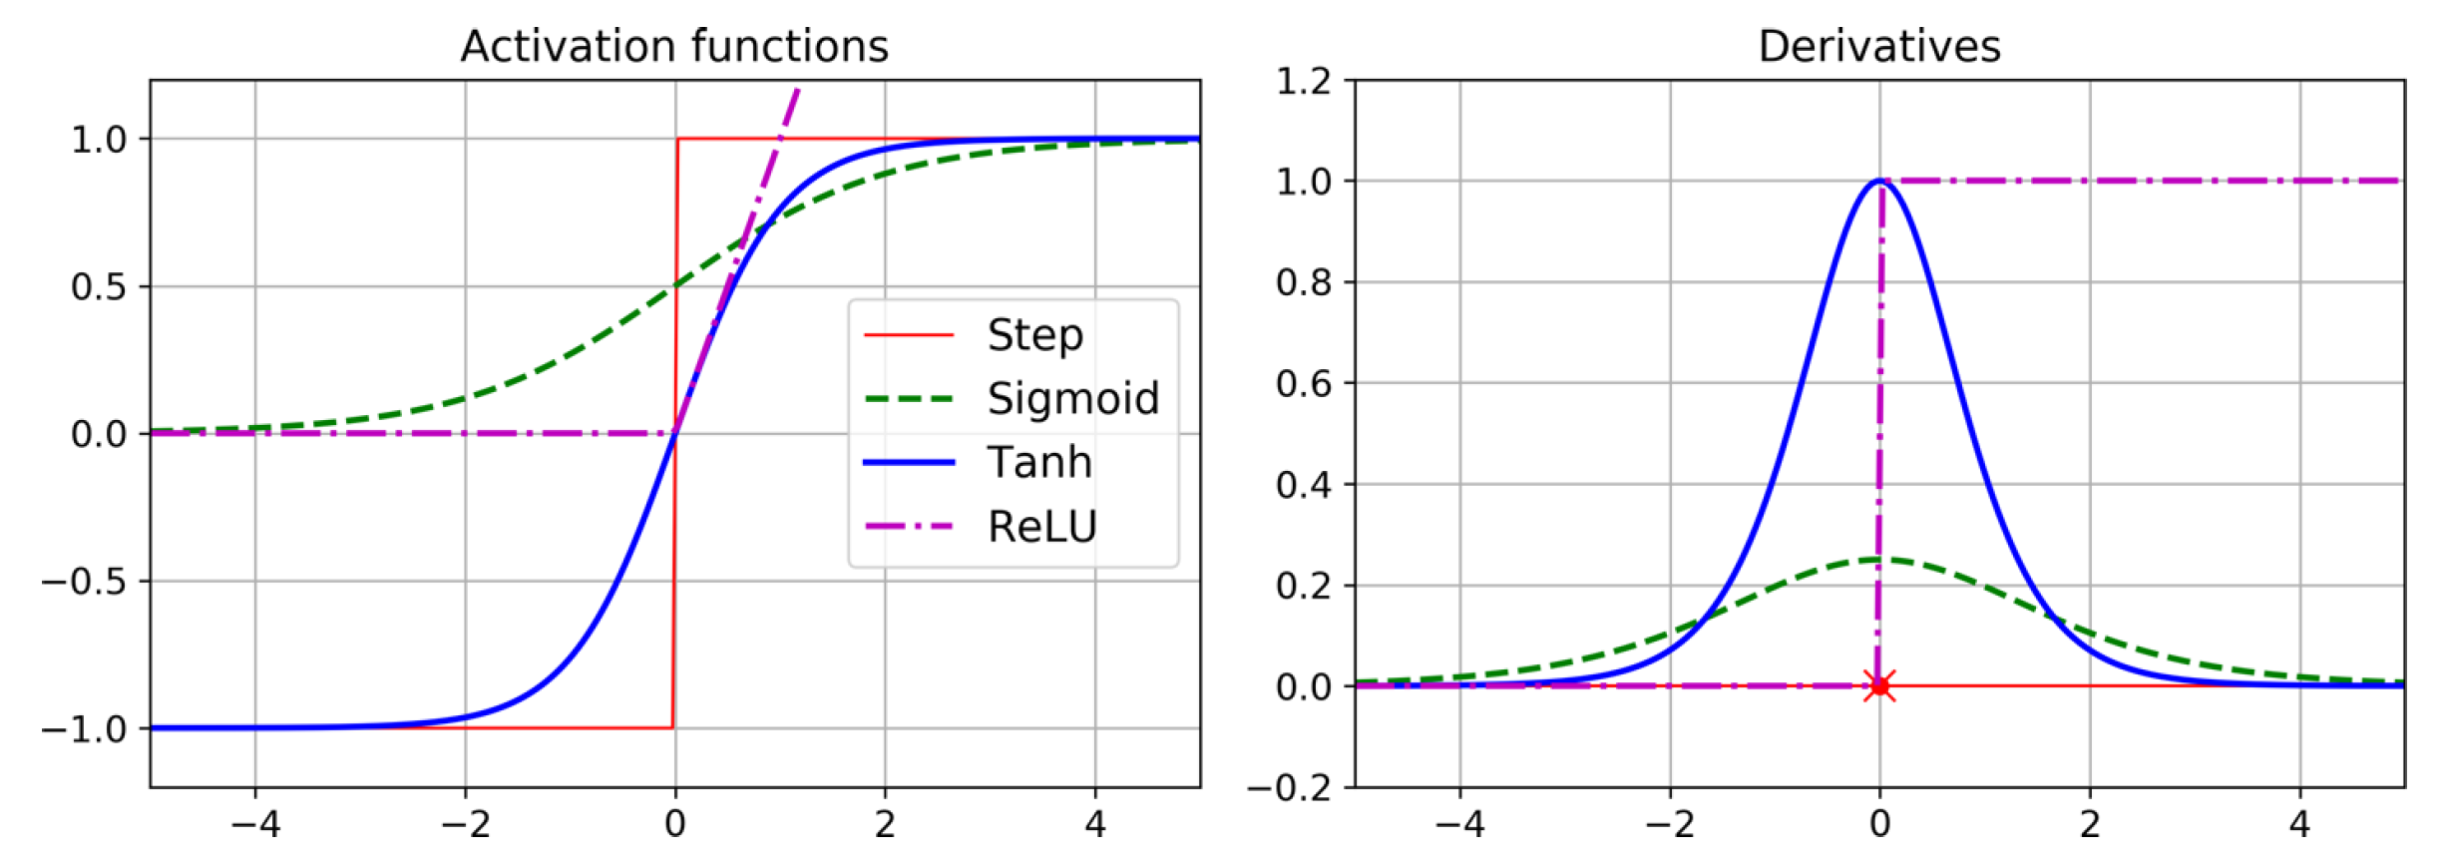

Slide 20
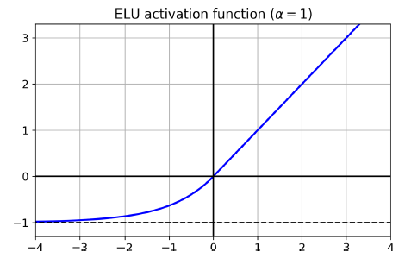
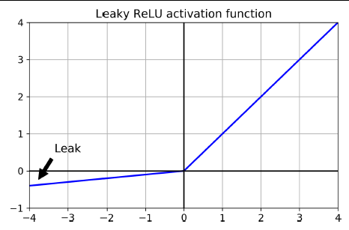
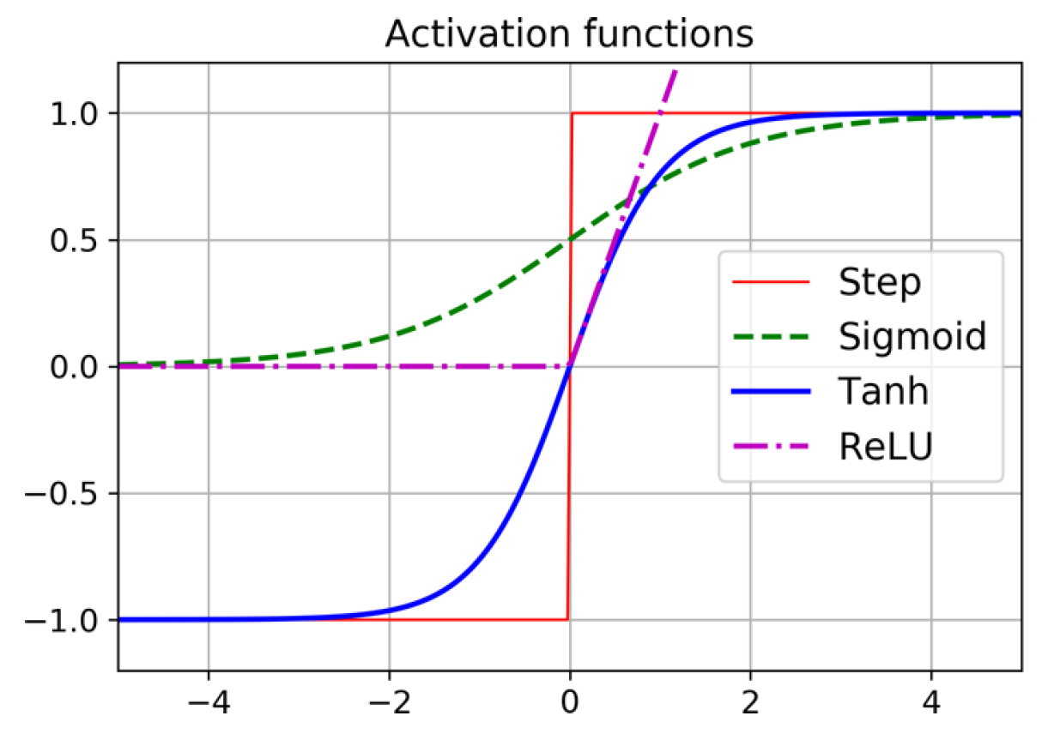
Choose activation function: SELU > ELU > Leaky ReLU > ReLU > tanh > Logistic

Slide 21
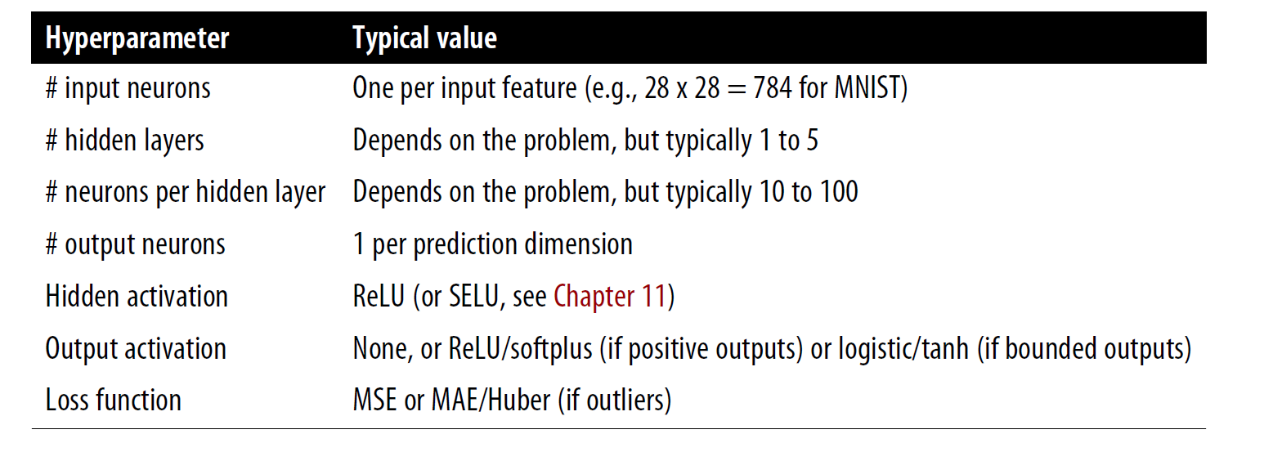
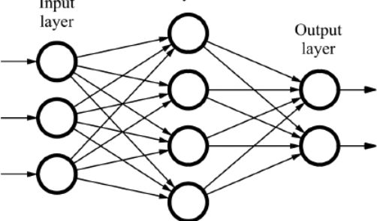
Hyperparameters related to the architecture
Smallest power of 2 to not create bottleneck (Chollet)
logistic/softmax (classification)

Slide 22

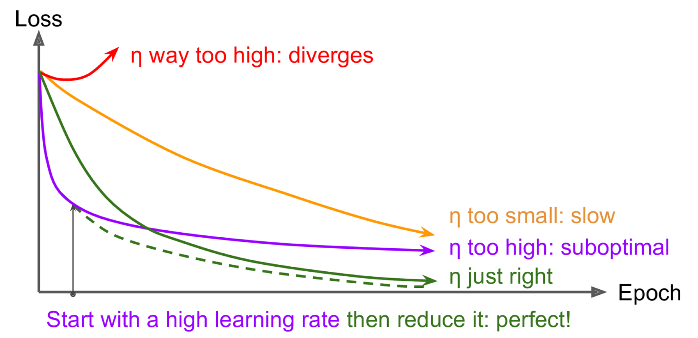
Hyperparameters related to the training
Loss function:
MSE, MAE, Huber (outliers) for reg.
Cross-entropy for classification
Batch size, Initialization of weights
Optimizer
Learning Rate
Source: towardsdatascience.com

Slide 23
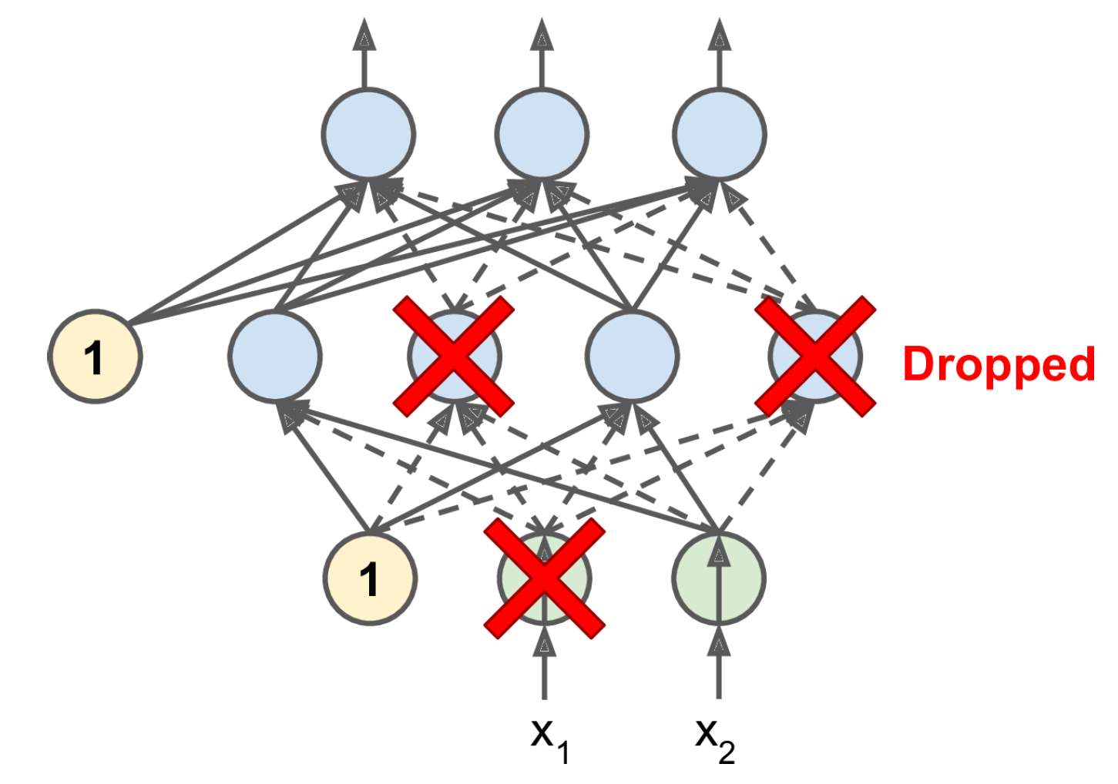
Avoiding Overfitting Through Regularization
L1/L2 regularization: Loss += |Weights,Biases| + (Weights,Biases)²
Batch normalization: Automatically scale inputs using (mean , standard deviation) calculated over the batch
Dropout (also used to add uncertainty)

Slide 24
Questions about Géron Ch10 & Ch11
" I think I don't understood correctly the activation function, and the link with the linearity and the activation functionI don't understood either how the gradient descent works in this case. "
What is the role of a Bias Neuron in a TLU and does the TLU work if the Bias Neuron is ommited?
What is an API ?
batch size and callbacks(especially how early stopping works ) are not really clear
How is the number of layers chosen? In the examples in this chapter, the choice seems quite arbitrary.
activation function?
Why are they different activation functions?
I didn't understand the Perceptron and the the differences between tensor flow an the other application programming interfaces
I didn't understand the vanishing problem.
i don't really understand what is freezing related to reusing layers
After these two chapters, it is still not clear to me how hidden layers are determined - how many, which activation function etc.
"- Reusing Pretrained Layers - Nonsaturating Activation Functions--> use?"
What is the difference between normal dropout and MC dropout ?

Slide 25
Min 45-60: Moodle Quiz (5 questions, 15 min)
Learning Objectives (Géron Ch10 & Ch11):
Define an artificial neural network
Understand activation functions
Understand the steps & best practices to build an artificial neural network
Know the main hyperparameters defining a neural network’s architecture
Know the main hyperparameters controlling the training of an NN
Notes:
Questions?
Not graded

Slide 26
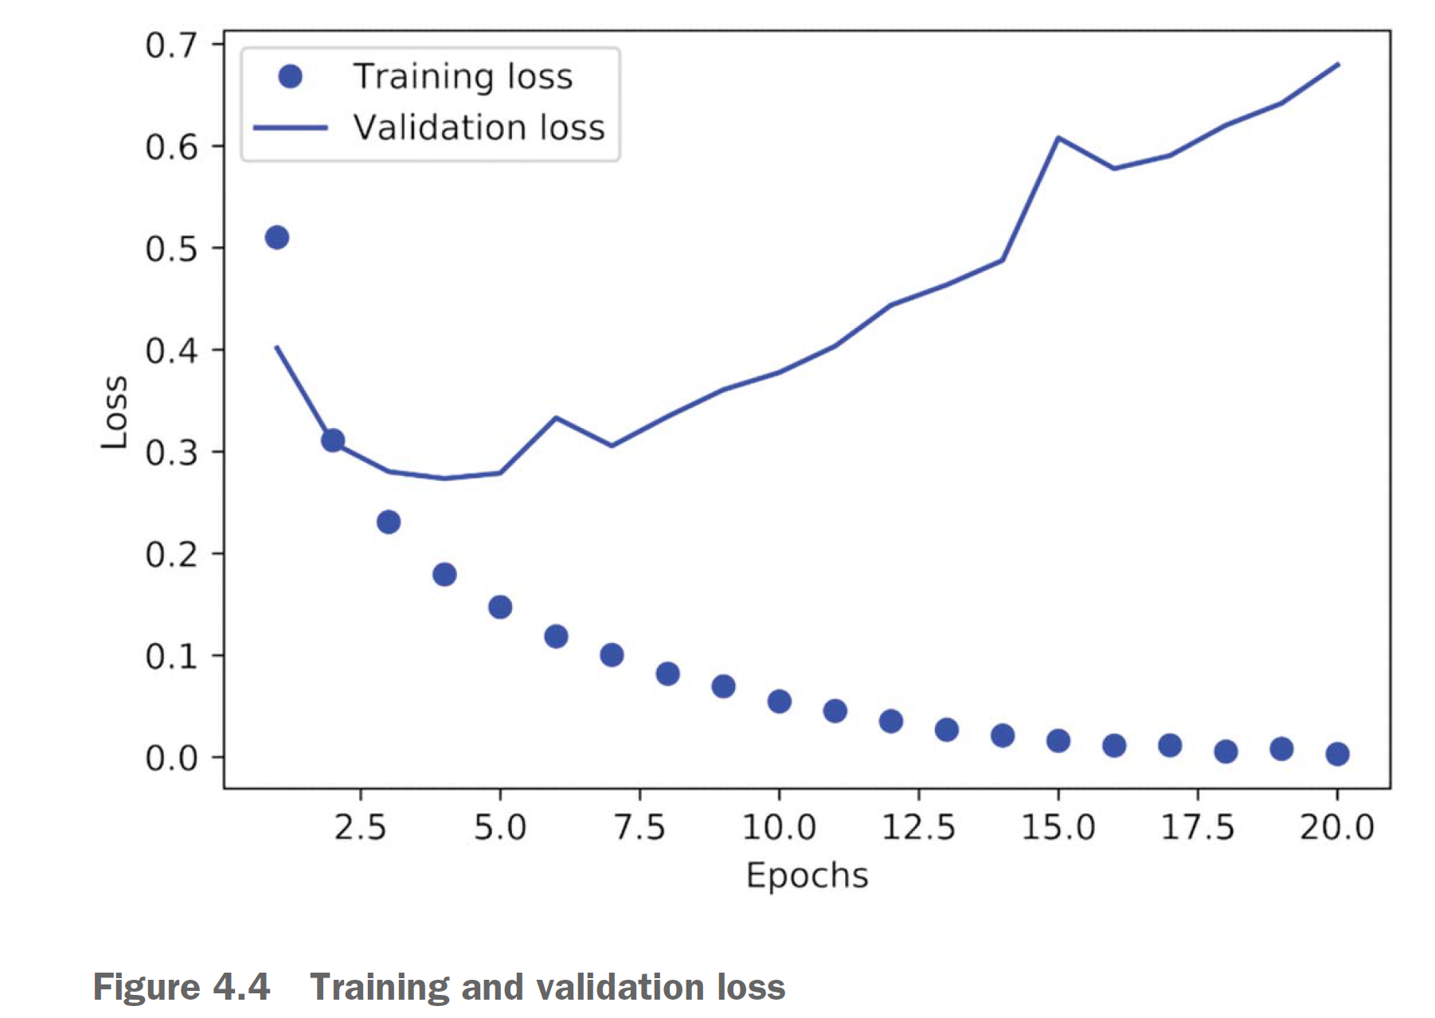
Learning curves for the question “Next steps after training”
Source: Deep Learning with Python (Chollet)

Slide 27

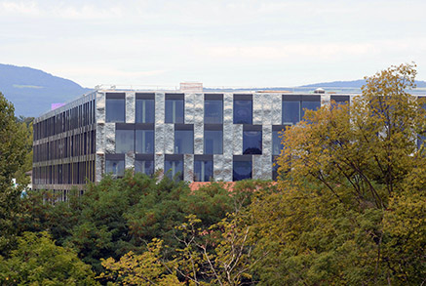
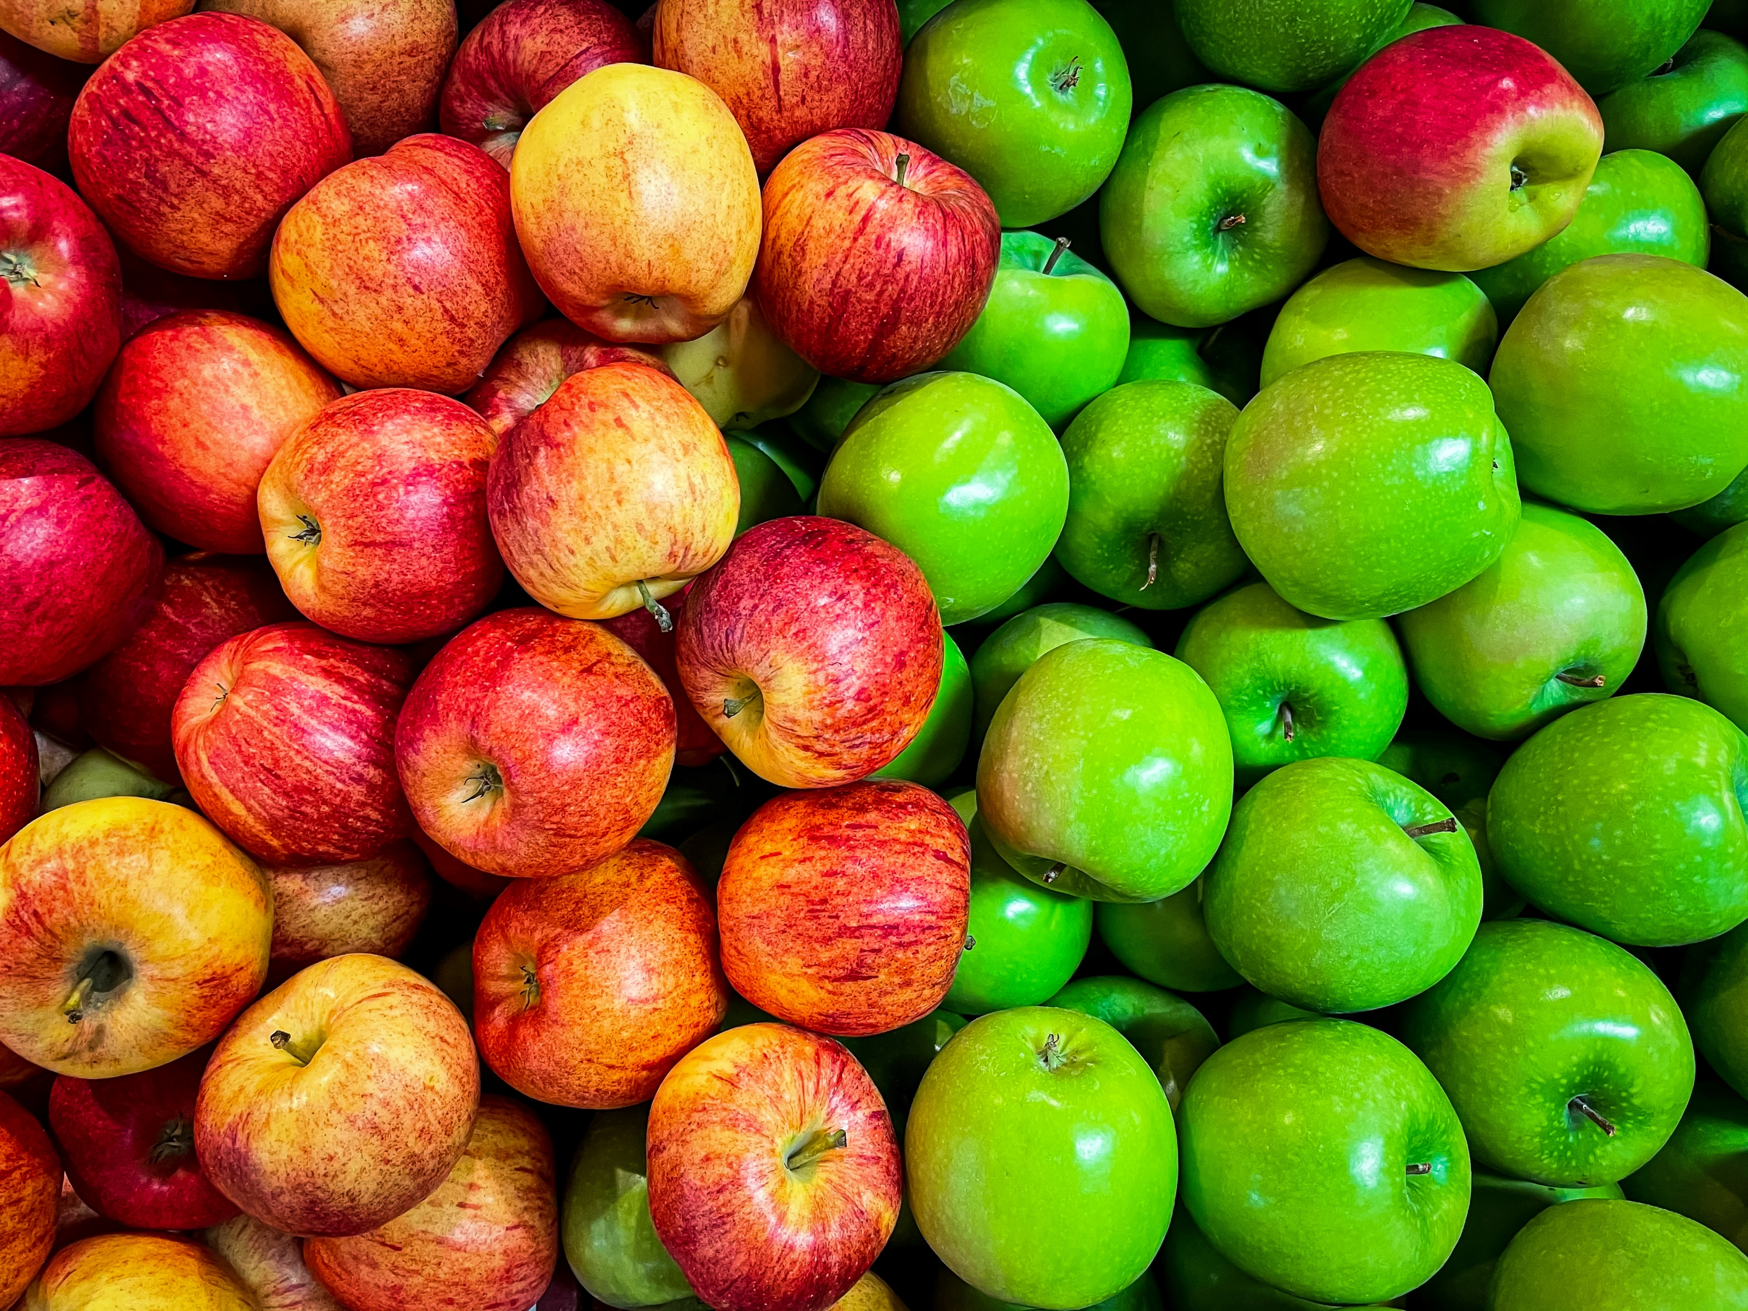
Min 60-75: Break

Slide 28
Min 75-85: Deep Learning to Emulate the Components of Earth System Models
Learning Objectives (Géron Ch8):
How to reduce the dimensionality of an environmental dataset in practice?
What can we learn by clustering complex environmental datasets?
Re-read the article and write down (1) the scientific goal of the paper; (2) One simple question with your neighbor. Example: How did the authors choose their best neural network architecture?

Slide 29
In a climate model, can we replace an expensive model of storms with a NN?
Problem: - The full-complexity storm-resolving models are too expensive to run
- Current climate models forced to rely on empirical models of clouds

Slide 30
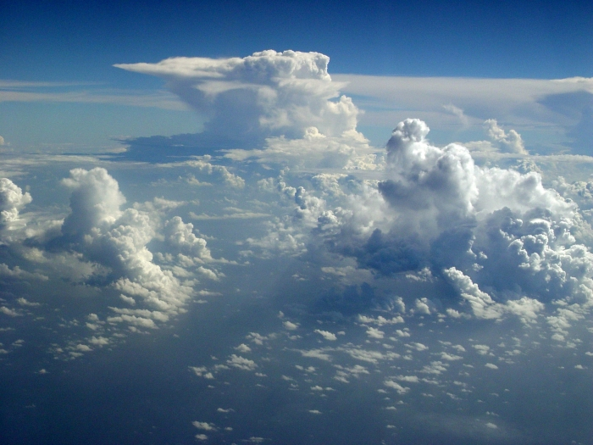
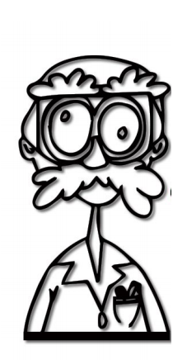
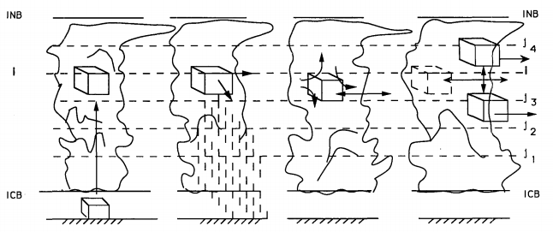
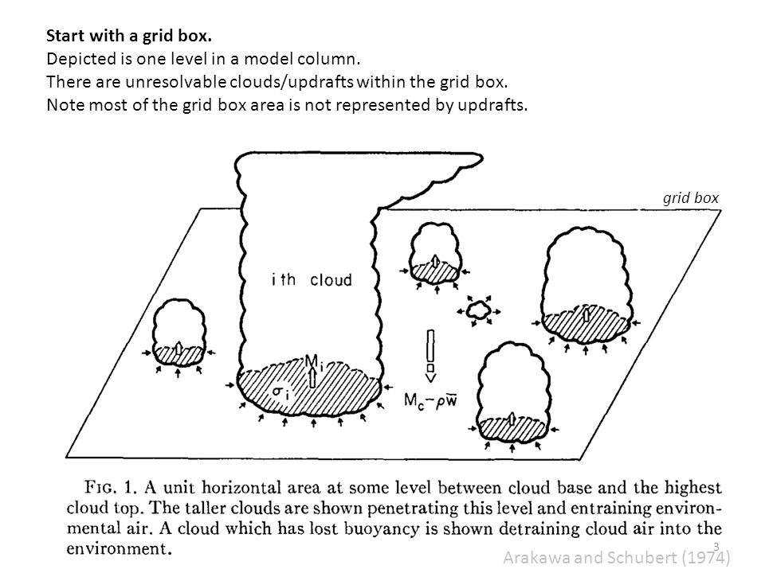
100 km
Problem: - The full-complexity storm-resolving models are too expensive to run
- Current climate models forced to rely on empirical models of clouds
Idea: Train an artificial neural network from high-resolution simulation data Result: Neural networks can accurately emulate effects of storms on climate
Source: C. Bretherton, S. Rasp, Arakawa and Schubert, Emanuel

Slide 31
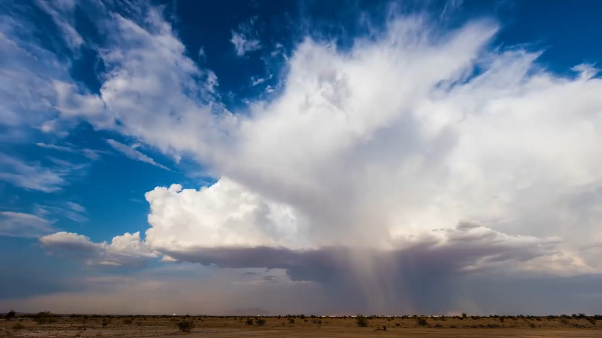
Atmospheric Convection = Atmospheric motion driven by air density differences
Notes:
Atmospheric convection is the atmospheric motion driven by air density differences, often from the sun heating the surface resulting in less dense air that then ascends, which is exactly what is happening in this storm during the North American Monsoon. As convection form clouds that interact with radiation [BREAK] and interact with storms that transport heat, water, and tracers such as dust, atmospheric convection is responsible for fast vertical energy transfer between the surface, the atmosphere and space.

Slide 32
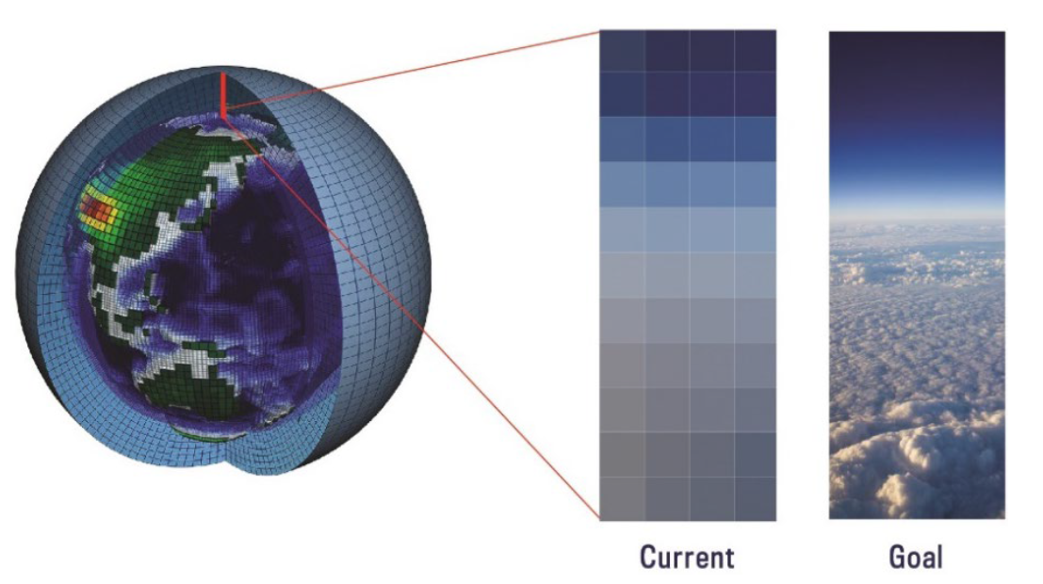
Motivation 1: Largest uncertainties in climate projections from clouds
Source: Zelinka et al. (2020), Meehl et al. (In Review), Gentine, Eyring & Beucler (2020)
Notes:
Because of their major importance for vertical energy transfer, we would like to resolve the effect of convection and clouds on the climate in our models because they are a major constraint on climate sensitivity. Unfortunately, models fail at representing these effects because most climate models use a coarse-grid with empirical models of clouds, which distorts the multi-scale interaction between climate, convection, and clouds. This leads to large uncertainties and explain why for a given emission scenario, the representation of clouds remain the primary source of uncertainty in our long-term climate projections, which is the first motivation for this talk.

Slide 33
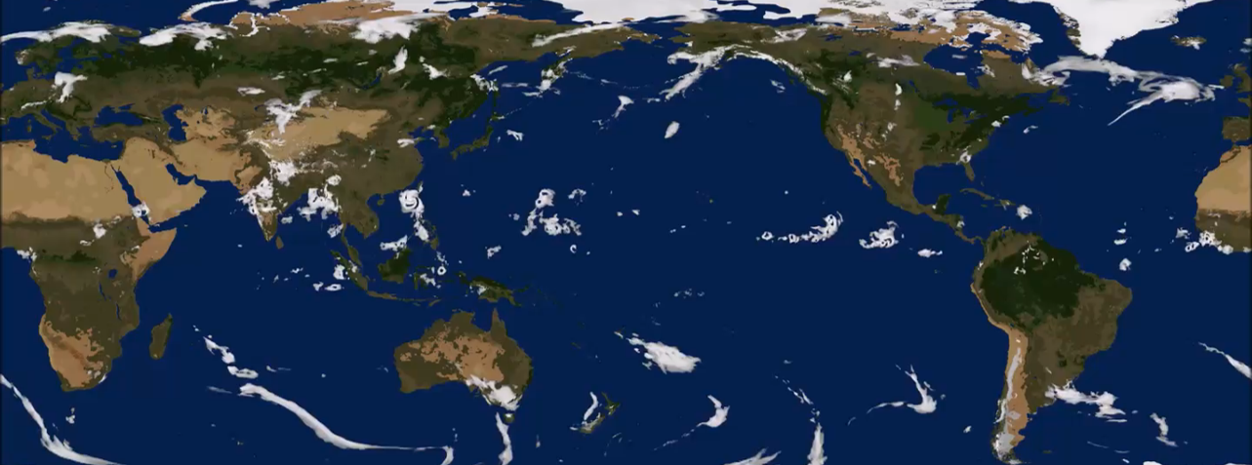
Motivation 1: Largest uncertainties in climate projections from clouds
Motivation 2: Global cloud-resolving models can resolve convection & clouds at $\sim$1km, but only for short period (1 year)
Source: Stevens et al. (2019), Sato et al. (2009), SAM: Khairoutdinov and Randall (2003), Lee and Khairoutdinov (2015)
Notes:
The second motivation is that thanks to computational advances, we are now able to run global simulations with a grid fine enough to explicitly simulate deep cloud systems. However, because of computational limits, we are only able to run such simulations for a short period of time, for instance 1 year, which pales in contrast to the hundred year simulations we need for long-term climate predictions.

Slide 34
Motivation 1: Largest uncertainties in climate projections from clouds
Motivation 2: Global cloud-resolving models can resolve convection & clouds at $\sim$1km, but only for short period (1 year)
Motivation 3: ML can accurately mimic $\sim$1km convective processes
See: Rasp et al. (2018), Brenowitz et al. (2018,2019), Gentine et al. (2018), Yuval et al. (2020), Krasnopolsky et al. (2013)
Notes:
In parallel to the development of global cloud-resolving models, progress in stochastic optimization & computational capabilities has improved machine learning algorithms- And in this talk, ML generally describes algorithms that learn to perform a task from data without being explicitly programmed for that task. So recent computational progress has *improved* ML algorithms to the point where they can be trained on these high-resolution simulations to accurately mimic the effect of deep cloud systems on climate. This requires a bit of context [switch]

Slide 35
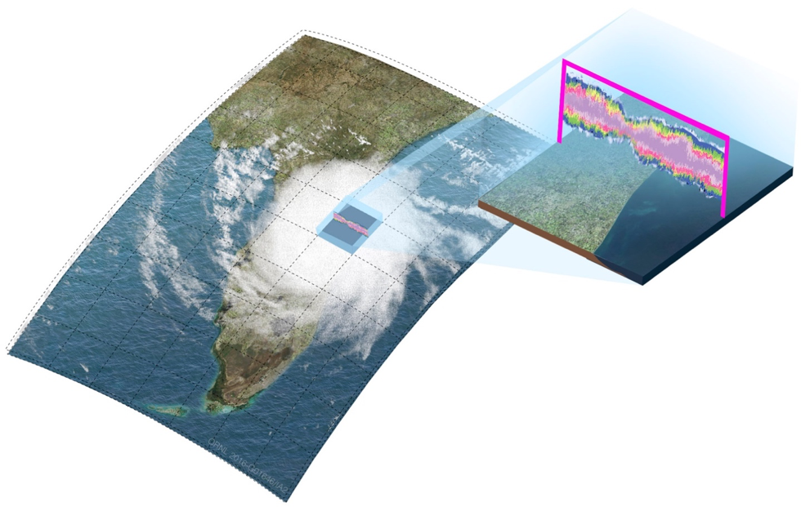
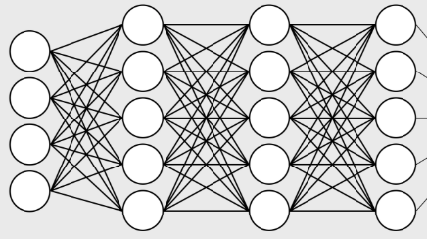
ML of Subgrid-Scale Thermodynamics
Neural Network:
20 times faster
Setup : Super-Parameterized climate model, Aquaplanet & Earth-like
Year 1 for training (≈50M samples), Year 2 for validation/test
Image source: e3sm.org, Model source: Khairoutdinov et al. (2004)
Notes:
In my research, I mostly rely on climate simulations that use the super-parametrized community atmospheric model, where the multi-scale nature of atmospheric thermodynamics is explicitly represented via the combination of (on the left) an exterior model almost identical to a traditional global climate model, and (on the right) an interior model, which is an expensive cloud-resolving model explicitly representing the response of convection and fine-scale turbulence to given large-scale thermodynamic conditions. The role of the neural network is to emulate and replace the interior model, which can make the climate model up to a hundred times faster with minimal accuracy trade-off.

Slide 36

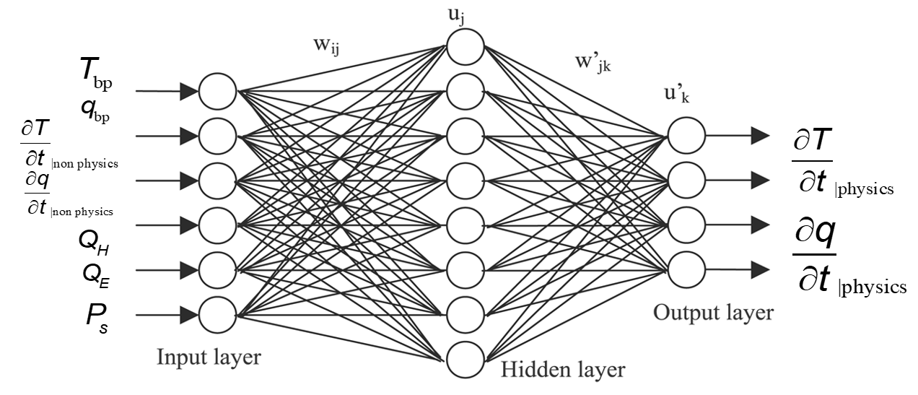
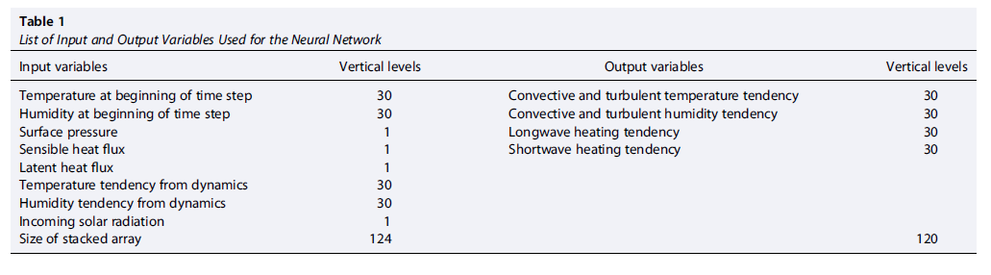

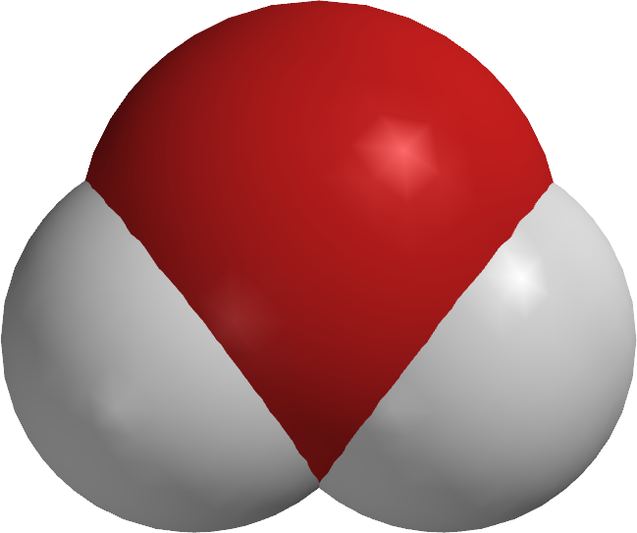

Radiative Fluxes
Insolation
Temperature
Subgrid
Heating
Specific
Humidity
Subgrid
Moistening
Surface Enthalpy Fluxes
Notes:
In our case, the details of the neural network can be adjusted for the modeling task at hand, but all the neural networks (define) I will present today take insolation, temperature, and specific humidity or water vapor concentration, and surface enthalpy fluxes as inputs. They then output subgrid-scale thermodynamics fluxes, which is how unresolved clouds and turbulence redistribute heat and water vapor in the vertical, as well as radiative fluxes at the surface and the top of the atmosphere.

Slide 37
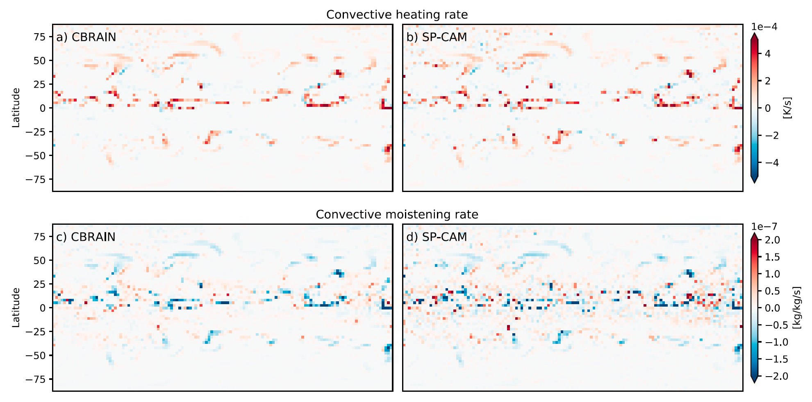
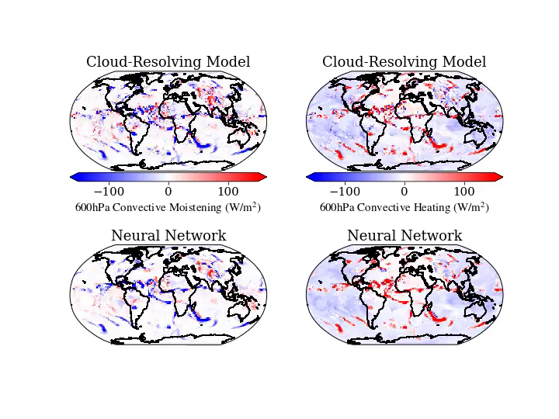
Truth
Super-param.
simulation
Prediction
NN
(offline)
Source: Mooers, Pritchard, Beucler et al. (2021)
See: Rasp et al. (2018), Brenowitz et al. (2018,2019), Gentine et al. (2018), Yuval et al. (2020), Krasnopolsky et al. (2013)
Notes:
Here is a movie showing the performance of such a NN at emulating subgrid-scale thermodynamics from a super-parametrized climate simulation with Earth-like boundary conditions, with the ground truth we are trying to emulate at the top, the NN prediction at the bottom, convective moistening on the left and convective heating on the right. We can see that it does extremely well given the complexity of the task at hand.
3 problems

Slide 38
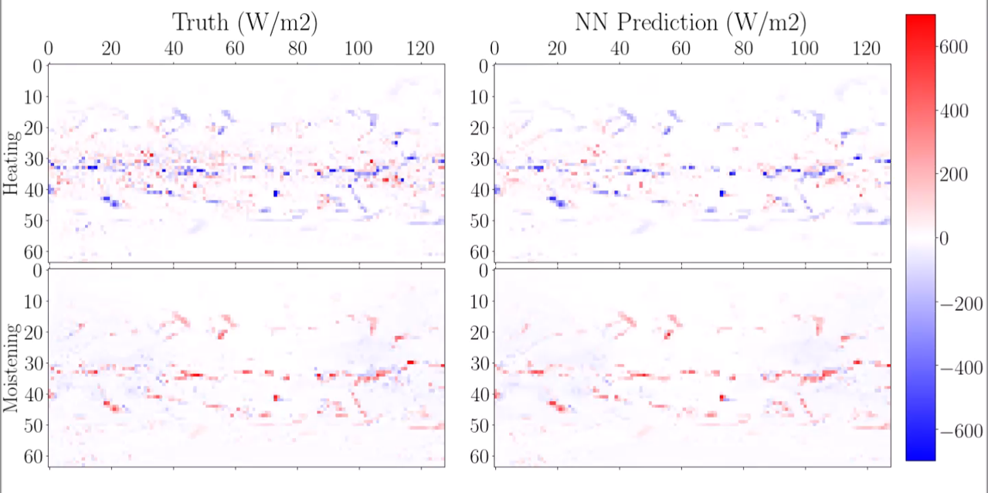

Slide 39
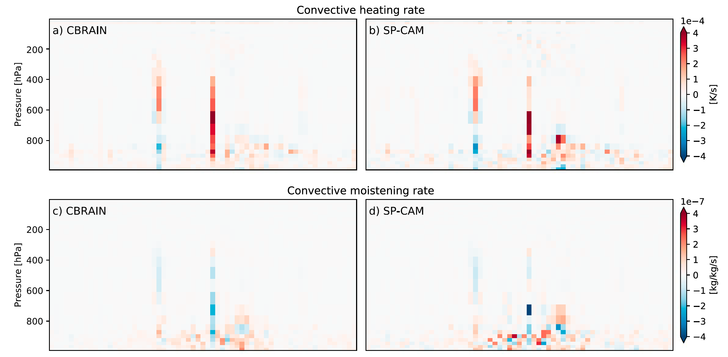
See: Rasp et al. (2018), Brenowitz et al. (2018,2019), Gentine et al. (2018), Yuval et al. (2020), Krasnopolsky et al. (2013)
Notes:
Here is a movie showing the performance of such a NN at emulating subgrid-scale thermodynamics from a super-parametrized climate simulation with Earth-like boundary conditions, with the ground truth we are trying to emulate at the top, the NN prediction at the bottom, convective moistening on the left and convective heating on the right. We can see that it does extremely well given the complexity of the task at hand.
3 problems

Slide 40
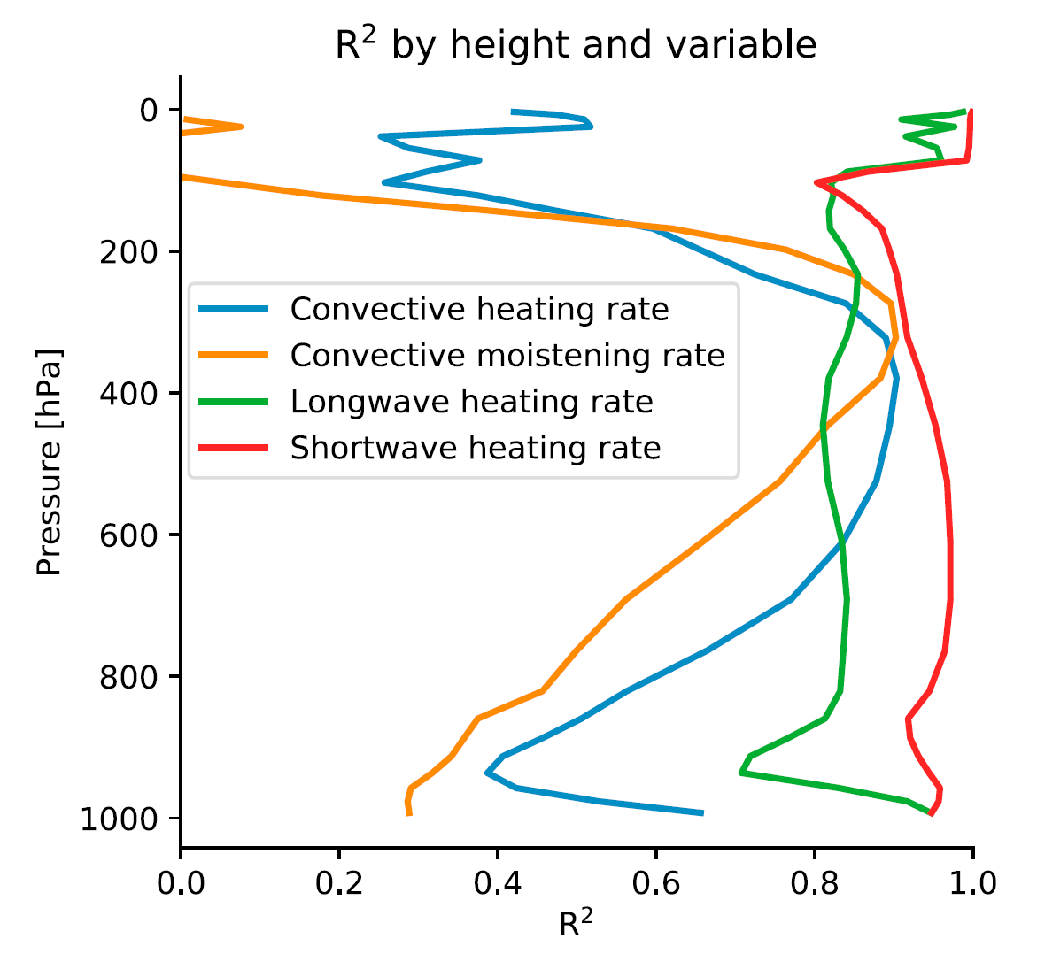
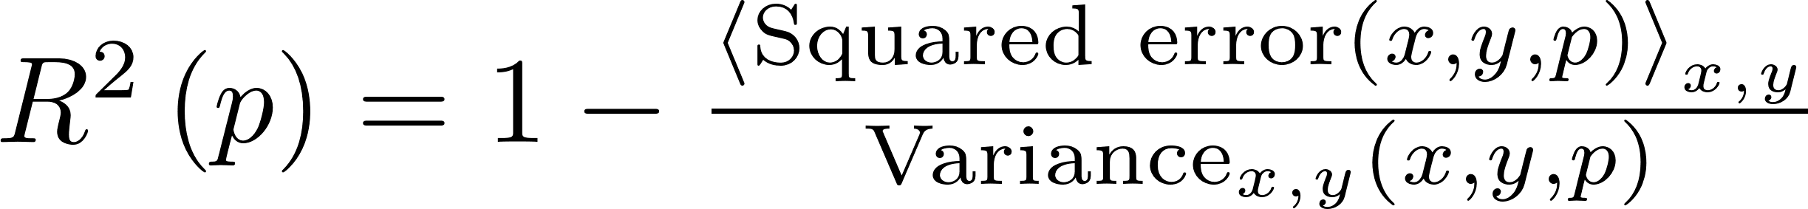
Coefficient of Determination
≠
Coefficient of Correlation

Slide 41
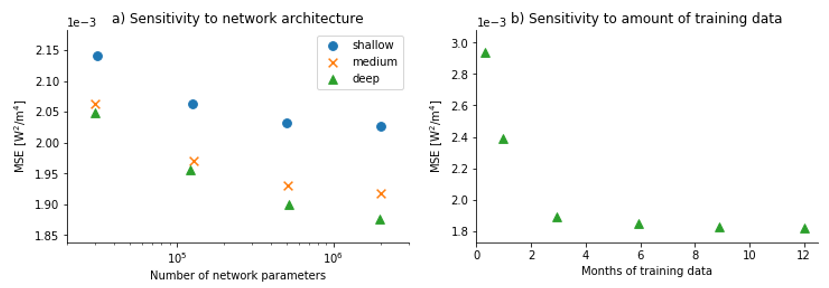
How did the authors choose their architecture?
Deeper and Wide neural networks are more accurate (universal approx. theorem)
More data helps, but 4 months is enough

Slide 42
Questions
could you explain figure 3? (didn't understand the variables)
I didn't really understand the difference with using a "bottom-up" or "top-down" strategy in CBRAIN.
"I did not understand what can be the advantages of not putting latitude and longitude information on the input vector.It is possible to summarize the article with simple terms.Thank you"
I have not found the Figs. S2a and S2b nor Tab. S1 mentioned in §4.1. I assume they are compiled in a supplement. Can you show us these figures? It would be interesting to visualise the differences in sensitivity to model architecture.
I think it could be useful to describe the next week's paper in class the week prior. As a geography student, while I understand that they built a machine learning model, I am not sure I know what it tries to predict, what is the data and even what is "moist convection in coarse scale climate model."

Slide 43
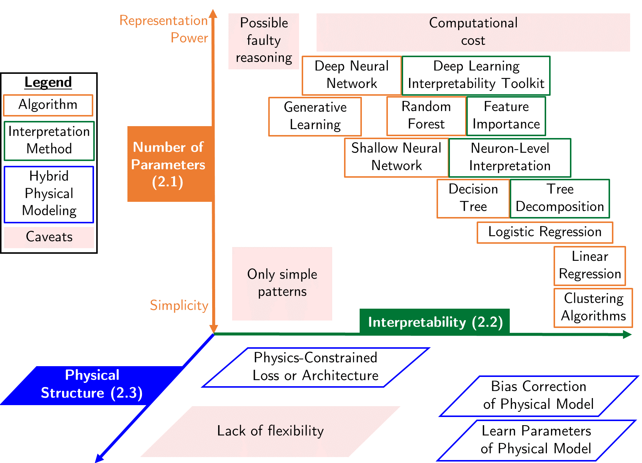
Source: Beucler et al. (2021)

Slide 44
Now let’s go back to the initial questions

Slide 45
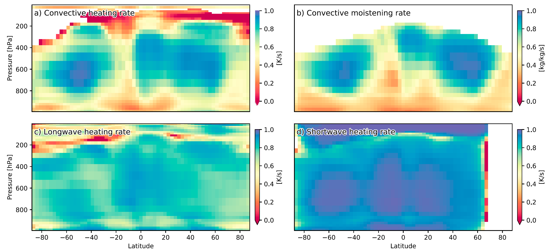

Slide 46
Min 105-120: Review Moodle Quiz
Learning Objectives (Moodle Quiz at Min 45 on Géron Ch5+6+7):
Name Support Vector Machines & understand their applicability
Know how to train & interpret a decision tree
Understand how to choose a regularization hyperparameter
Define a random forest
Know some advantages/drawbacks of ensemble modeling
Understand feature importance
Notes:
Questions?
Not graded

Slide 47
Start thinking about your final project and book a one-on-one meeting
The final project’s goal is to answer a well-defined scientific question by applying one of the ML algorithms introduced in class on an environmental dataset of your choice (e.g., related to your Masters thesis or your PhD research).
Can you think of a large environmental dataset linked to a scientific question you are passionate about?
In the affirmative, how could you format the dataset to facilitate its manipulation in Python?
In the negative, consider browsing the list of benchmark datasets maintained by Pangeo (http://mldata.pangeo.io/index.html), Kaggle, or browse the class syllabus’ datasets
One-on-one Meetings for Final Project: https://calendly.com/tom-beucler/final_project
If you have not already done so, register to the course by filling out this form: https://forms.gle/8fGjKU86XqZ3ghHu7
Notes:
Questions?

